Slide 1
Microservices
SE495: Software and Systems Integration

Slide 2
Outline
Introduction to Microservices
Microservices Architecture
Integration Patterns
Tools and Technologies

Slide 3
Introduction to Microservices

Slide 4
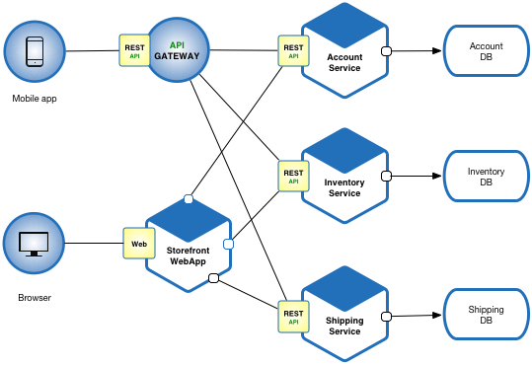
Microservices
Microservices is a software development architecture that involves breaking down a large application into smaller, independent components or services.
Each service is responsible for a specific function or feature of the application and communicates with other services through well-defined APIs.

Slide 5
What is Microservices?
“Microservices are a thing these days.”
Phil Calçado, former Director of Engineering, SoundCloud
“Microservices are small, autonomous services that work together.”
Sam Newman, Thoughtworks
“Loosely coupled service-oriented architecture with bounded contexts.”
Adrian Cockcroft, Battery Ventures
“A microservice is an independently deployable component of bounded scope that supports interoperability through message-based communication.”
“Microservice Architecture-Aligning Principles, Practices, and Culture”

Slide 6
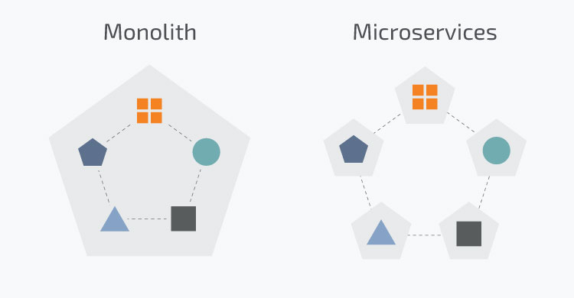
Microservices
Traditionally applications were built in a monolithic architecture style
Single unit with client-side apps, server-side apps and a database managed and served in one place
However, modern applications are built in a microservices architecture
Smaller, independent units that carry out every application process as a separate service

Slide 7
Why use Microservices?
Independent components that can be updated and deployed separately
A bug in one microservice does not impact any other microservice
Easier to understand and manage small units of code
Better scalability as each unit can scale independently
More freedom in tech selection as each microservice can use a different language and framework
But increase in complexity as each microservice needs to be able to talk to each other

Slide 8
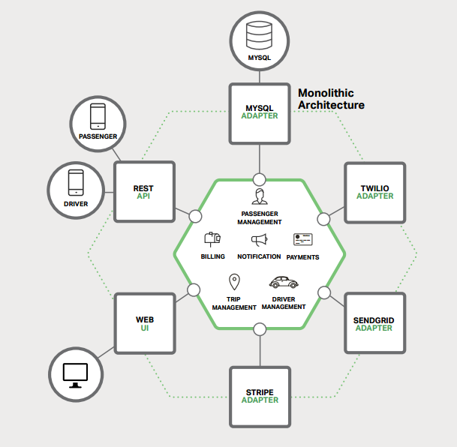
Building Monolithic Applications

Slide 9
Building Monolithic Applications
These applications are simple to test and debug.
These applications are also simple to deploy.
These applications are scalable.

Slide 10
Issues with Monolithic Applications
In time the application become too complex.
Being too large is very difficult for any developer to fully understand.
A large application is an obstacle to continuous deployment.
Another problem with monolithic applications is reliability.

Slide 11
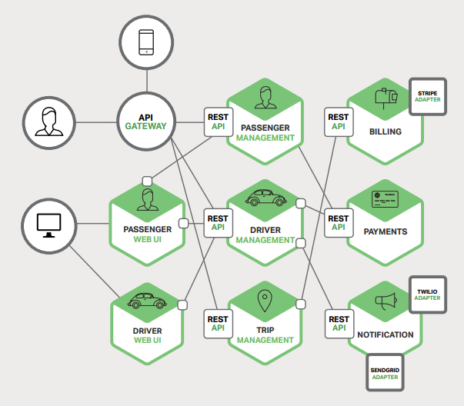
Microservices – Tackling Complexity

Slide 12
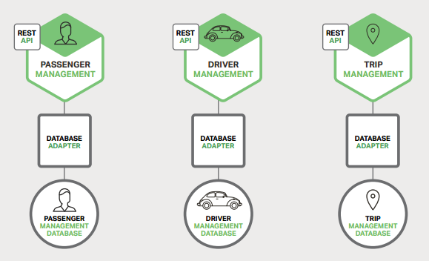
Microservices – Tackling Complexity

Slide 13
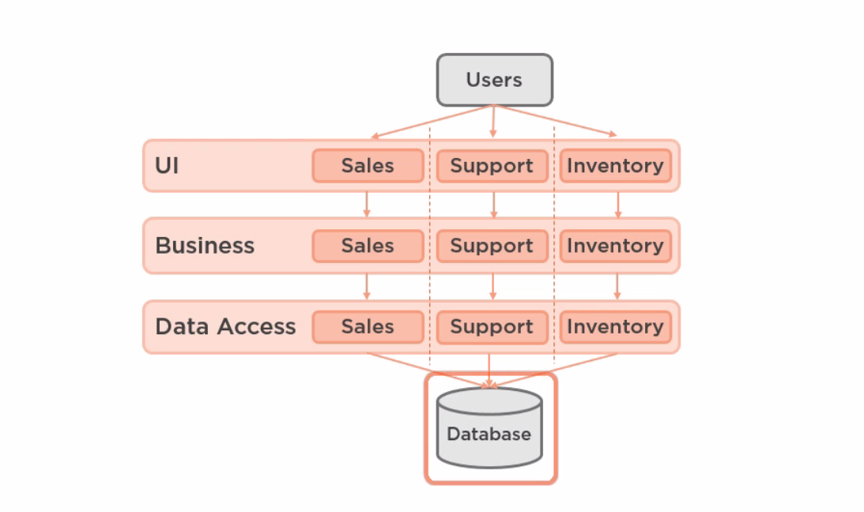
Why Microservices

Slide 14
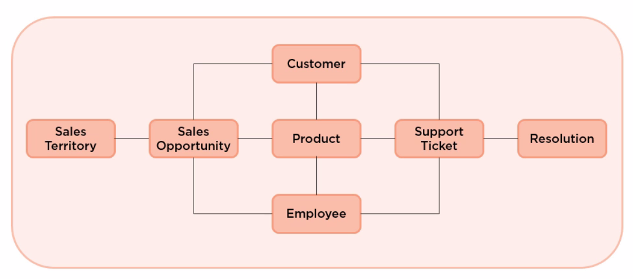
Why Microservices

Slide 15
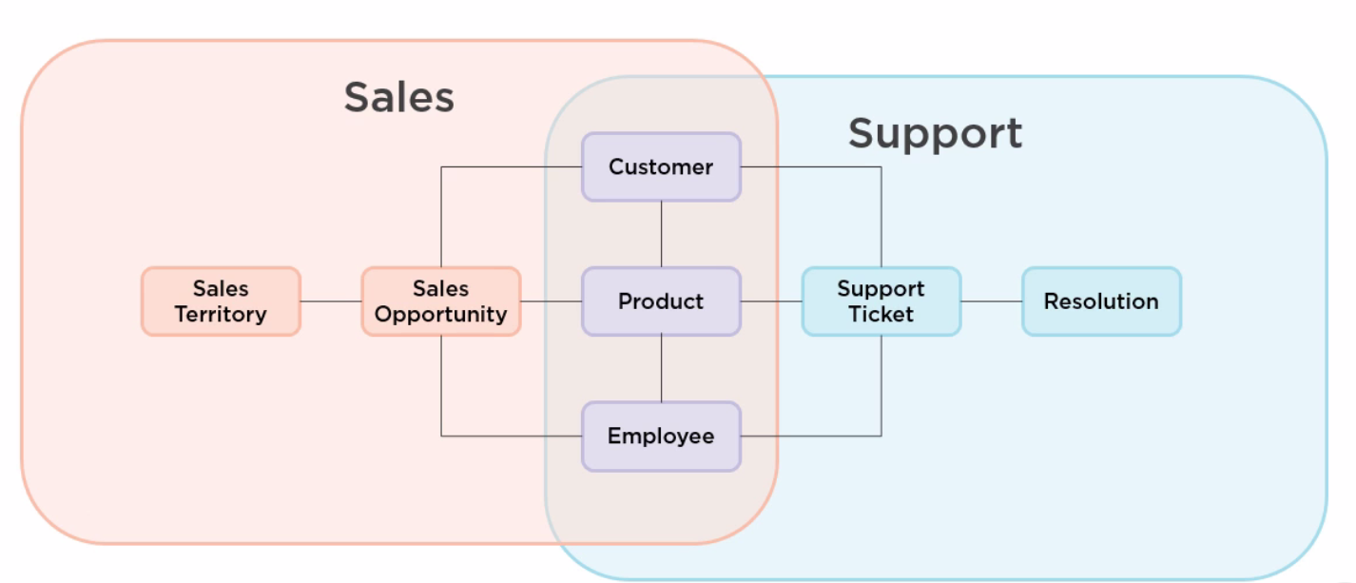
Why Microservices

Slide 16
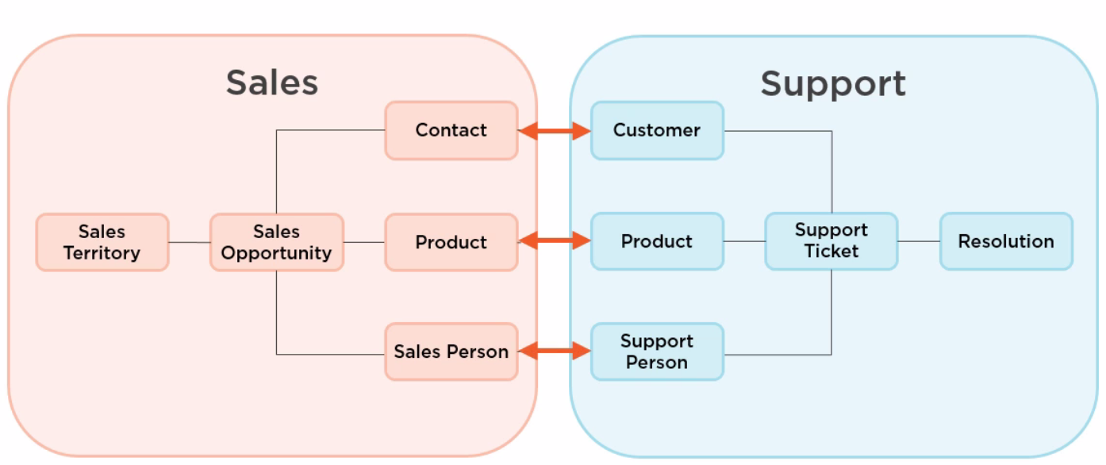
Why Microservices

Slide 17
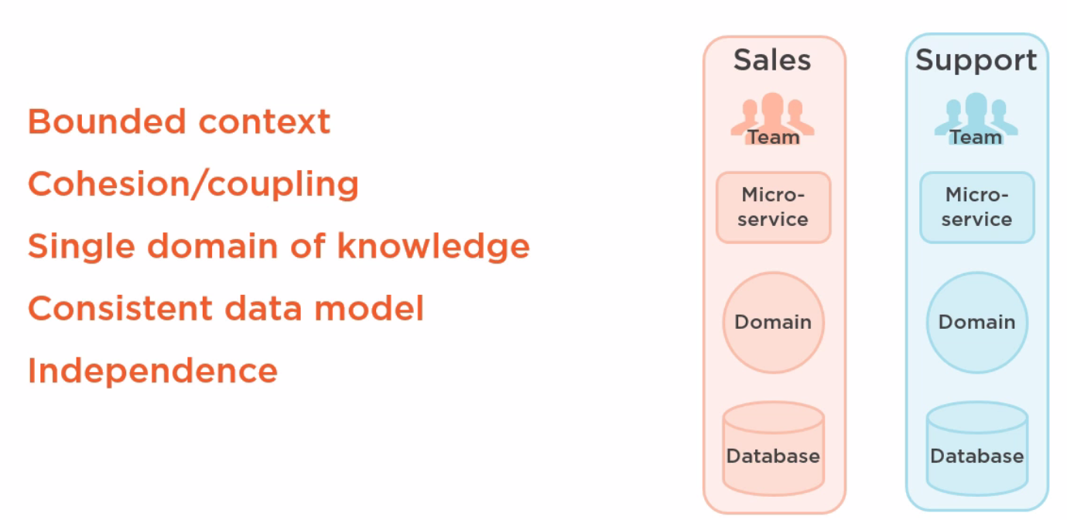
Why Microservices

Slide 18
Benefits of using microservices
Scalability
They are easier to scale individual components of an application independently
Flexibility
They allow developers to use different technologies and programming languages for different components of the application
Resilience
Failures in one service do not impact the entire application
Faster development and deployment
Microservices can be developed and deployed independently
Improved team collaboration
They encourage smaller, more focused development teams that can work more independently and collaboratively

Slide 19
Drawbacks of using microservices
Increased complexity
They add additional complexity to the development and deployment process, as multiple services must be developed, tested, and deployed independently.
Integration challenges
Because microservices are developed independently, there can be challenges in integrating them with other services and ensuring that they work together seamlessly.
Increased operational overhead
Managing multiple services can be more complex and require more resources than managing a single monolithic application.
Testing challenges
Testing microservices can be more complex than testing a monolithic application, as each service must be tested independently and in conjunction with other services.
Performance overhead
Because microservices communicate with each other over APIs, there can be additional performance overhead compared to a monolithic application that has direct access to all components.

Slide 20
Microservices Architecture

Slide 21
Key components of Microservice architecture
Microservices
Self-contained services that can be any language and function separate from one another, making them ideal for implementation through various software teams.
Containers
A package of software that functions independently and works to isolate each service in the same environment.
Service mesh
It is responsible for the communication between microservices via a messaging layer.
Service discovery
Helps manage deployment and evenly distribute the load.
API gateway
Communication in the complex distributed microservices architecture.

Slide 22
What are microservices?
A model of technical architecture
Small independent functional applications
Each microservices built on appropriate technical components
A software development pattern
Decentralization of technical components
Distributed programming / DevOps teams
Responsibility to deploy, operate, and maintain services

Slide 23
From apps to systems
Many microservices are assembled to create a complex business application
Separate independent components
Brought together via middleware or API gateway

Slide 24
Software Development Styles
Monolithic Applications
Codebase of application deployed as a single bundle of executables and libraries on a unified platform
Microservices Architecture
Multiple independent software components orchestrated to form a unified application
Common infrastructure:
User interface toolkit
API Gateway
Persistence layer

Slide 25
An internal architecture
Not necessarily apparent to users whether the application is based on microservices
Needed for fast performance, high availability, extreme transaction loads
Decentralized architecture does not imply fragmented user experience

Slide 26
Who uses Microservices
Uber
Netflix
Amazon
Ebay
Twitter
PayPal

Slide 27
Alternative approach: Monolithic software
Consolidated executable application
Plus supporting libraries and modules
Can be massively distributed across computing clusters
Entire application based on a uniform technology stack:
Server platform
Operating system
Programming language
Database layer
Enhancements mean recompilation of entire application

Slide 28
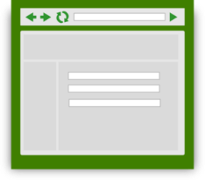

Monolithic Application Conceptual Model
Scripts/ Third Party Systems
User Interfaces
API endpoints
Web service
Presentation Layer
Application software Business Logic
Run time libraries
Database Engine
Table
Table
Table
Table
Table
Table
Table
Table
Table
Table
Table
Table
Table
Table
Table
Table

Slide 29
Services-oriented Architecture
Longstanding approach to business application development
Monolithic application based on reusable services
Complex applications rely on an enterprise service bus to manage communications among services, database connectivity, event triggers, etc
Single uniform technology platform
Code assembled into a monolithic package
Scales to very high performance through clustered deployment

Slide 30
SOA development issues
Services are closely interrelated throughout the application
Developers must understand all aspects of the application
Single technology stack
Small changes require full recompilation
Complex applications can hit hardware or OS limits
Centralized development pattern
Operations separated from Development

Slide 31
Monolithic Application: Enterprise SOA Model
Scripts/ Third Party Systems
User Interfaces
API endpoints
Web service
Presentation Layer
Application software Business Logic
}
Reusable
Composable Services
Enterprise Service Bus
Database Engine
Table
Table
Table
Table
Table
Table
Table
Table
Table
Table
Table
Table
Table
Table
Table
Table

Slide 32
Building a microservice
Small unit of functionality
Complete and independent technology stack
Separate data stores
Synchronization with other services as needed through persistence layers
Invoked through API Request / Response
Usually: REST, HTTP, JSON
Self-contained components
Inner workings not exposed externally
Developers have free reign to select tech components

Slide 33
Microservice conceptual model
Request
Response
REST / HTTPS
Microservice
Web service
Service components
Application software
Run time libraries
Data Store

Slide 34
Assembling an application
Each microservice performs a small limited task
Not intended to be standalone applications
Surrounded by specialized infrastructure
Manage communications
Orchestrate services into complex chains of tasks
Load balancing
API Gateway
User Interface layer
Externally exposed APIs
Multiple instances of any microservice launched as needed

Slide 35

Microservices-based Application
Scripts/ Third Party Systems
User Interfaces
API endpoints
Presentation Layer / UI Toolkit
API Gateway
Microservice
Web service
Microservice
Microservice
Microservice
Service components
Web service
Web service
Web service
Microservice
Service components
Service components
Service components
Web service
Microservice
Microservice
Microservice
Service components
Application software
Web service
Web service
Microservice
Microservice
Web service
Service components
Service components
Web service
Web service
Service components
Application software
Application software
Service components
Application software
Service components
Run time libraries
Application software
Application software
Run time libraries
Application software
Run time libraries
Run time libraries
Application software
Application software
Data Store
Application software
Run time libraries
Run time libraries
Data Store
Run time libraries
Data Store
Data Store
Run time libraries
Run time libraries
Run time libraries
Data Store
Data Store
Data Store
Data Store
Data Store
Data Store
Persistence / System Layer

Slide 36
Beyond Virtual Machines to Containers
Virtual machines are a common technology for optimizing use of computing hardware
Most applications use a small portion of computing and storage capacity
VM managers enable multiple instances of operating environments to co-exist on each physical server

Slide 37
Virtual Machine Environment
Multiple Virtual Machines can share a single physical server
VMs allocated via a Virtual Machine Monitor or Hypervisor
Each VM contains its own operating system, code libraries, applications, web services, and other components
Each VM independent: can host any OS, libraries, apps
VM-1
VM-2
VM-3
VM-4
Apps
Apps
Apps
Apps
Code libraries
Code libraries
Code libraries
Code libraries
Guest OS
Guest OS
Guest OS
Guest OS
Virtual Machine Monitor
Host operating system
Server Hardware

Slide 38
Containers
Server hardware provides OS Kernel to any container
Code libraries and binaries, memory, disk storage, and other resources residing on the server can be provisioned to any container
Containers can be rapidly deployed based on pre-defined configuration sets
Containers require fewer resources: do not run an entire copy of OS and support services
Containers can differ or replicate
High demand microservices may require many instances
Containers share resources but are designed to be rigidly independent
Container engine ensures against resource collisions
microservice
microservice
microservice
microservice
microservice
microservice
microservice
microservice
Binaries / Libraries set A
Bins / Libs B
Container Engine (eg: Docker)
Host operating system
Server Hardware

Slide 39
API Gateway
Requests to microservices usually not made directly from external agents
Need a layer to manage access to Microservices to enable flexible deployment
Multiple microservices may be required to perform a complex task
Usually many instances of each microservice
API Gateways provide a single entry point for all requests into the application.
Developers do not need to know physical address of each service (nothing should be hardwired)
Manage authentication, protocol conversions, communications, routing, load balancing

Slide 40
DevOps
Merges development with operations
A single team takes responsibility for development, deployment, operations, and maintenance of a microservice
Make independent technology decisions
Programming language
Databases
(probably limited to contain technical overhead for the organization)
No need to understand all aspects of the application

Slide 41
Contracts
Any given microservice will not necessarily be aware of all the ways in which it is consumed
Microservices must be persistent to avoid failures in the broader application / ecosystem
Agreement to provide specific requests/responses
Versioning is an essential characteristic
Any deprecation must be (technically) negotiated and propagated through the microservice ecosystem
Functionality cannot be withdrawn until it is no longer required

Slide 42
Docker
Leading technical environment for the management of containers
Supported in most infrastructure environments
Amazon Web Services

Slide 43
Containers
Allocate computing resources in even smaller increments than Virtual Machines
Share low-level components
Self-contained pre-configured operating environment
Container management environments provide fast and easy approach to deploy microservices or other computing components
Used in all types of computing environments, but especially well suited to microservices.

Slide 44
Container orchestration
In a complex environment tools are needed to manage the deployment of containers
Components need to be allocated and deallocated dynamically based on load and demand
Examples:
Docker Swarm
Kubernentes (developed by Google)
Apache Mesos

Slide 45
Benefits of Microservices
Rapid development
Quick path to MVP (minimal viable product)
Distributed teams
Modularity
Scalability

Slide 46
Evolving from the Monolith to Microservices
Many organizations eventually press the limits of applications built with SOA monolithic style
Gradually offload selected tasks to microservices
Full-fledged migration to microservices can be long and expensive

Slide 47
Characteristics of microservices
Self-contained
Microservices do not have external dependencies. They manage their own data and implement their own user interface.
Lightweight
Microservices communicate using lightweight protocols.
Implementation-independent
Microservices may be implemented using different programming languages and may use different technologies in their implementation.
Independently deployable
Each microservice runs in its own process and is independently deployable, using automated systems.
Business-oriented
Microservices should implement business capabilities and needs, rather than simply provide a technical service.

Slide 48
Microservice communication
Microservices communicate by exchanging messages.
A message that is sent between services includes some administrative information, a service request and the data required to deliver the requested service.
Services return a response to service request messages.
An authentication service may send a message to a login service that includes the name input by the user.
The response may be a token associated with a valid user name or might be an error saying that there is no registered user.

Slide 49
Microservice characteristics
Each microservice should have a single responsibility i.e. it should do one thing only and it should do it well.
However, ‘one thing only’ is difficult to define in a way that’s applicable to all services.
Responsibility does not always mean a single, functional activity.

Slide 50
Password management functionality
User functions
Supporting functions
Create password
Check password validity
Change password
Delete password
Check password
Backup password database
Recover password
Recover password database
Check database integrity
Repair database DB

Slide 51
Microservices architecture – key design questions
What are the microservices that make up the system?
How should data be distributed and shared?
How should microservices communicate with each other?
Microservices architecture
design
How should the microservices in the system be coordinated?
How should service failure be detected, reported and managed?

Slide 52
Synchronous and asynchronous microservice interaction
Synchronous – A waits for B
Asynchronous – A and B execute concurrently
Service A
Service A
Processing
Waiting
Processing
Processing
Processing
Calls
Requests (B)
Queue B
Queue A
Returns
Requests (A)
Processing
Processing
Processing
Processing
Service B
Service B

Slide 53
Direct and indirect service communication
Direct communication – A and B send message to each other
Service A
Service B
Indirect communication – A and B communicate through a message broker
Message broker
Service A
Service B

Slide 54
Microservice data design
You should isolate data within each system service with as little data sharing as possible.
If data sharing is unavoidable, you should design microservices so that most sharing is ‘read-only’, with a minimal number of services responsible for data updates.
If services are replicated in your system, you must include a mechanism that can keep the database copies used by replica services consistent.

Slide 55
Inconsistency management
An ACID (atomicity, consistency, isolation, durability) transaction bundles a set of data updates into a single unit so that either all updates are completed or none of them are.
ACID transactions are impractical in a microservices architecture.
The databases used by different microservices or microservice replicas need not be completely consistent all of the time.

Slide 56
Inconsistency management
Dependent data inconsistency
The actions or failures of one service can cause the data managed by another service to become inconsistent.
Replica inconsistency
There are several replicas of the same service that are executing concurrently. These all have their own database copy and each updates its own copy of the service data. You need a way of making these databases ‘eventually consistent’ so that all replicas are working on the same data.

Slide 57
Eventual consistency
Eventual consistency is a situation where the system guarantees that the databases will eventually become consistent.
You can implement eventual consistency by maintaining a transaction log.
When a database change is made, this is recorded on a ‘pending updates’ log.
Other service instances look at this log, update their own database and indicate that they have made the change

Slide 58
Service coordination
Most user sessions involve a series of interactions in which operations have to be carried out in a specific order.
This is called a workflow.
An authentication workflow for UID/password authentication shows the steps involved in authenticating a user.
In this example, the user is allowed 3 login attempts before the system indicates that the login has failed.

Slide 59
Orchestration and choreography
Service orchestration
Service Choreography
Authentication controller
Login service
Password
service
Login service
Password
service
Authentication events

Slide 60
Failure types in a microservices system
Internal service failure
These are conditions that are detected by the service and can be reported to the service client in an error message. An example of this type of failure is a service that takes a URL as an input and discovers that this is an invalid link.
External service failure
These failures have an external cause, which affects the availability of a service. Failure may cause the service to become unresponsive and actions have to be taken to restart the service.
Service performance failure
The performance of the service degrades to an unacceptable level. This may be due to a heavy load or an internal problem with the service. External service monitoring can be used to detect performance failures and unresponsive services.

Slide 61
Timeouts and circuit breakers
Timeout
A timeout is a counter that this associated with the service requests and starts running when the request is made.
Once the counter reaches some predefined value, such as 10 seconds, the calling service assumes that the service request has failed and acts accordingly.
The problem with the timeout approach is that every service call to a ‘failed service’ is delayed by the timeout value so the whole system slows down.
Circuit breaker
Instead of using timeouts explicitly when a service call is made
Like an electrical circuit breaker, this immediately denies access to a failed service without the delays associated with timeouts.

Slide 62
Using a circuit breaker to cope with service failure
Service S1
Service S2
Circuit breaker
Check S2
availability
S2 available
Set timeout
Route service request
S2 unavailable
retries <=3
Check timeout
Response S2
availability
Set S2
unavailable
retries >3
timeout fail
Increment retries
Route service response
timeout OK

Slide 63
State of the Art
Business environments based on monolithic style remain viable
Trend to base new large-scale web applications on microservices
Well accepted, modern approach among tech giants
A technical style that supports a level of scale not previously possible
Beginning to gain acceptance for mid-scale development projects.

Slide 64
Library Context: FOLIO
New open source library services platform based on the microservices architecture
FOLIO
Open source library services platform
Designed for multitenancy
Based on Microservices architecture
Designed for multiple deployments
In development phase: expect first libraries to go into production in 2018

Slide 65
EBSCO Supports new Open Source Project
FOLIO
the Future of the Library is Open
https://www.folio.org/
A community collaboration to develop an open source Library Services Platform designed for innovation.
American Libraries feature:
https://americanlibrariesmagazine.org/2016/04/22/ebsco-kuali-open-source-project/

Slide 66
FOLIO background
Initially oriented to academic libraries
Academic libraries interested in Library Services Platform
Narrow options (Ex Libris Alma, OCLC WorldShare Management Services)
Unbundle Discovery from Resource Management
Choice for patron-facing services
Alternative functional approach based on apps and modules

Slide 67
Technology
Microservices architecture
Modular
Enables choice for discovery
Pluggable modules
Not monolithic

Slide 68
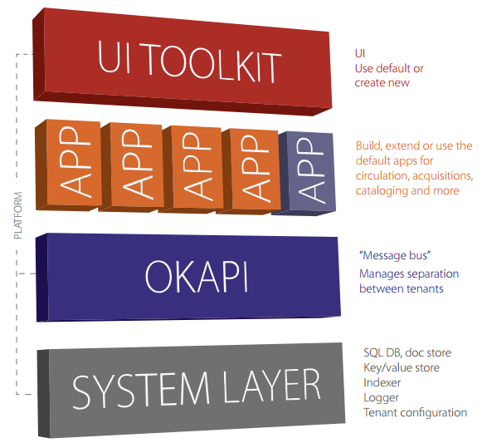
FOLIO Platform

Slide 69
Integration Patterns

Slide 70
Microservices Integration Patterns
Microservices architecture involves breaking down a monolithic application into smaller, independent services that work together to provide the functionality of the overall application.
Integration patterns are used to define how these services communicate and interact with each other.

Slide 71
Decomposition – defining services
Domain driven design
Tactical DDD
Domain
Core Domains
Aggregate
Aggregate
(s)
Candidate for single Microservice - Defines consistent boundary around an entity or set of entities – models the transactional boundary for business functionality through a root entity
Supporting Domains
Entity
Entity
(Root &
Sub-entity)
Data with unique identity that’s persisted – identified with unique value within data store
Value Object
No unique identity – dependent on an entity and stores additional attributes
Generic Domains
Value
Object

Slide 72
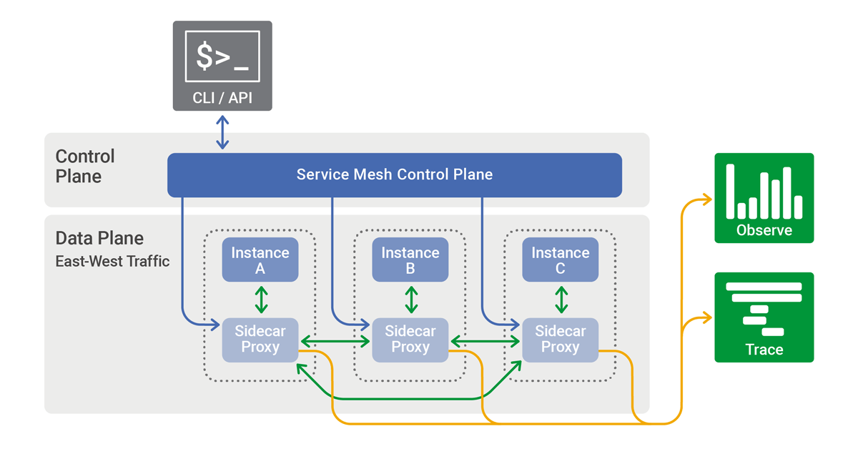
Decomposition - deployment
Sidecar
https://istio.io/
https://linkerd.io/
Infra layer within your architecture
Transform Coexist Eliminate
Observability and tracing
Encryltion and mutual TLS between services
Service discovery & load balancing
Controlling traffic flow by applying routing rules
Support for canary and blue/green deployment
Switch / LB
Strangler Facade
3
2
Microservices
1
Legacy

Slide 73


Cross cutting concerns
Common patterns used in all Microservices
External
Configuration
Service Discovery
Circuit Breaker
Security
01
External Configuration
02
Service Discovery
Externalize all config – override based on environment
Can use Spring Cloud Bus to dynamically update “@ConfigurationProperties” and “@RefreshScope” beans
Register & discover services – follows cloud native architecture to isolate clients from tight coupling to service
Implementation – Eureka, Consul, K8S services etc
03
Circuit Breaker
04
Security
Handle inter service failures - When the number of consecutive failures crosses a threshold, the circuit breaker trips, and for the duration of a timeout period, all attempts to invoke the remote service will fail immediately
API first approach indicates that each endpoint should be protected based on the authorization schema
Use OAuth2 and JWT/Header to propagate the user authentication principle

Slide 74
Database patterns
Database per Service
Shared Database
Event Sourcing and CQRS
Write API (CUD of CRUD)
Read API (R of CRUD)
Users
Users
Tasks
1
Tasks
Event Queue
Comments
5
Event Handler
Comments
2
3
4
Event Store
Application Store

Slide 75
Integration – Chained Microservices
Synchronous call state management
Message oriented state management
Event Driven state management
Experience
Place Order
Order Summary
Place Order
Order Summary
Place Order
Order Summary
7
1
Message Queue
Event Propagation
Products
Payments
2
Products
Payments
Products
Payments
Event Store
Domain
Shipping
Orders
3
Shipping
Orders
Shipping
Orders
6
4
Events – orderPlaced, paymentMade, paymentDeclined, readyToShip etc
5
Authentication
Authentication
Authentication
System
Audit Trail
Audit Trail
Audit Trail

Slide 76



Integration – API Gateway
Common front for all APIs
cv
Proxy service to route requests to concerned Microservice, abstract out details of actual data producer
Prevent access to services that are internal to the application
Can act as Aggregator - fan out requests to multiple services (in parallel or in sequence) and then aggregate the result back to the consumer
Either the API gateway can act as an aggregator
Or depending on business complexity and number of clients – we can have a dedicated aggregator service
Can also convert the protocol request (e.g. AMQP) to another protocol (e.g. HTTP) and vice versa so that the producer and consumer can handle it.
Different options
Software gateway like Zuul & Spring Cloud Gateway
Tools like Apigee, IBM Cloud Gateway, Kong etc
Platform APIs
AuthN/ AuthZ
Scheduler
Config Svc
Browser Clients
Service Proxy
Reporting
/api/*
Experience APIs
Dash
board
APIs for:
Experience Layer,
Aggregators,
Orchestrators
API Gateway
Order Summary
Mobile App
Clients
Cart
Approval List
Domain/Core APIs
Account
API Clients
(3rd party Systems)
APIs for:
Fine Grained
at Domain Entity.
Some Directly
exposed.
Payments
Statement
Products
Orders
User

Slide 77
Transaction Patterns - Saga
Handle transactions in distributed systems*
Choreography-based saga
Orchestration-based saga
* Order Accepted
Place Order
* Order Rejected
Place Order
Inventory Reserved
Reserve Inventory
Reserve Inventory
inventory
* Order Pending
Order service
1
Make Payment
Cancel Order
1
Shipping
inventory
Order Saga
payment
3
2
Payment Success
Inventory Reserved
Release Inventory
Payment Status
* pending
* Accepted
* Rejected
3
Payment Failure
Order
success
Shipping
payment
2
* As much as possible – model your bounded context to be self contained and avoid distributed transactions

Slide 78
Observation & Monitoring
Critical to troubleshoot issues with distributed systems
Log Aggregator
Perf Monitoring
Distributed Tracing
Health Check
Centralized logging service that aggregates logs from each service instance – can be used to search & analyze the logs and trigger alerts based on patters.
Eg: ELK / EFK stack, Amazon cloud watch, Graylog etc
Monitor patterns so that application performance can be tracked & alerted for issues
APM tools like AppDynamics, NewRelic etc have agents running with the Microservice that PUSH data to monitoring service
Tools like Prometheus PULL metrics from the Microservice
Follow a single logical request (the trace) as it spans through multiple services( each being a span) that get called – specially relevant for Microservice chaining and aggregation
Eg: Zipkin, Jaeger, Appdash
Provide specific endpoint (such as /health) that provides information on whether the service is healthy or not.
Critical to orchestrate APIs using container orchestration platform like Kubernetes
Eg: Spring Actuator framework, socker based ping checks etc

Slide 79
Integration Patterns
API Gateway Pattern
This pattern involves using a single entry point for all client requests.
The API gateway is responsible for routing requests to the appropriate microservice and handling cross-cutting concerns such as authentication and authorization.
Service Registry Pattern
Each microservice registers itself with a service registry, which maintains a list of available services and their endpoints.
Other microservices can then discover and communicate with these services through the registry.

Slide 80
Integration Patterns
Event-Driven Architecture Pattern
This pattern involves using events to trigger actions across microservices.
When an event occurs, it is published to a message broker, which distributes the event to all microservices subscribed to that event.
Choreography Pattern
This pattern involves each microservice communicating with other microservices directly, without a central orchestrator.
Each microservice is responsible for responding to events triggered by other microservices.

Slide 81
Integration Patterns
Saga Pattern
This pattern is used to manage distributed transactions across multiple microservices.
When a transaction involves multiple microservices, the saga pattern ensures that all of the services involved have completed their part of the transaction before committing the transaction as a whole.
Circuit Breaker Pattern
This pattern is used to handle failures in microservices.
When a microservice fails, the circuit breaker pattern isolates the failed service and redirects requests to a fallback service until the failed service recovers.

Slide 82
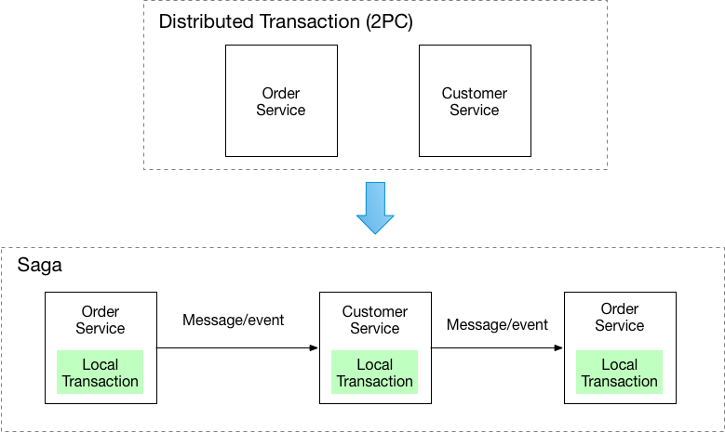
Saga

